Slide 1
VMware vExpert
vExpert Best Practice Guide
Application & Appeal Essentials. Deep Dive into Application, Voting, and Appeal Processes.
Corey Romero
vExpert Program Manager / Corporate Marketing
Notes:
Click to add notes

Slide 2
vExpert - Best Practice Guide
Table of Contents
vExpert: Application Preparation
Which Path Should You Choose?
Guidelines for Application: What to Include
Guidelines for Application: What to Leave Out
The Application Review Process
The Voting Process Outlined
Application Appeal Process
VMUG Community Contributions & How to Get Involved
Growing Your Network - Use the Follow Me Thread

Slide 3
vExpert - Application Preparation
Key Steps and Tips for Success
Account Creation: Make sure your profile details are accurate and complete. If you have a CC (VMware Customer Connect) account, match the email address for both vExpert and your CC account. We use CC to issue VMware licenses once you’re awarded vExpert.
Best Practices : This document will outline the application process (what to include/exclude),
When to Apply: You can apply year-round, use the vExpert application as a personal diary to note all your contributions though out the year. Applications are only closed when we are voting.
Submission Period: Is the time when you should finalize any app details before the closing date. We have two submission periods, one from December to January and another from June to July.
How Often to Apply: All vExperts need to re-apply each year during the Dec to Jan submission period. All awards expire even if you were awarded in July during the second half award announcements. If you miss the first period, you can apply during the second.
Asking for Help: We are always willing to help with any vExpert related questions.
One option is to work with a voter directly, who are the vExpert PRO’s. You can find the PRO’s at vexpert.vmware.com/directory and you might find someone you already know, feel comfortable with and or local to your city or country. Each PRO has several contact methods listed in their profile. The vExpert PROs are friendly and very helpful, another thing that makes this community so amazing to work with.
Another option is under Contact Us on the homepage of vexpert.vmware.com. Please ask questions, we are always happy to help answer questions.

Slide 4
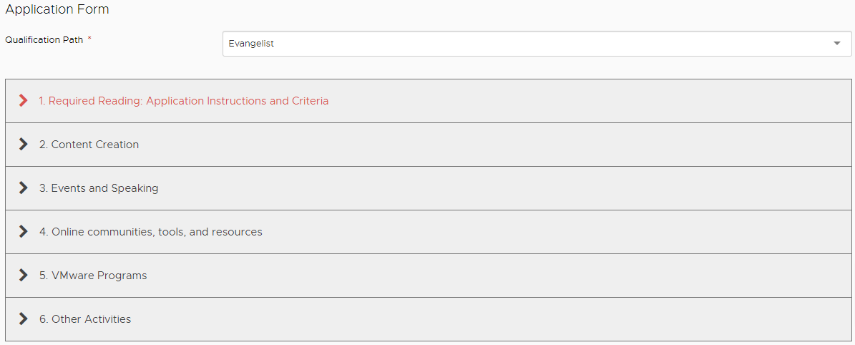
vExpert - Which Path Should You Choose?
The First Steps and Which Path is Right for You
Applying for the Award
What Path Should You Choose?
When you apply at vexpert.vmware.com/apply, you will be required to
select a path. This path selection helps us gain a better understanding of who you are and does not affect the outcome or your experience in the program.
After choosing a path, it is crucial to provide detailed information in the
following four areas: "Content Creation”, "Events and Speaking”, "Online
Communities, Tools and Resources”, and "VMware Programs”.
If you have a VMware Employee as a reference, it is beneficial to include their information in your application.
•Evangelist Path encompasses book authors, bloggers, tool builders,
public speakers, and other IT professionals who share their knowledge
and passion through personal public platforms.
•Customer Path is for internal evangelists and community leaders from
VMware customer organizations who contribute to success stories,
references, interviews, talks, and community engagement.
•Partner is for partner company employees who demonstrate
passion, continuous learning, and share their technical expertise through
various means such as event participation, videos, IP generation,
and public speaking engagements.
•VMUG Leadership* consists of Active Leaders, Co-Leaders or on the Steering Committee with a reference from the Chapter Leader.
•VCDX* is for those who hold the VCDX title. Some may also fall into other paths. Choose what single path that best describes you. Program membership, content and experience is the same across all paths.
•VMTN Moderator* is reserved for VMTN Moderators who dedicate personal time to the community by moderating forms, working with the VMware Community Manager.
*Auto Approval after verification has been completed.

Slide 5
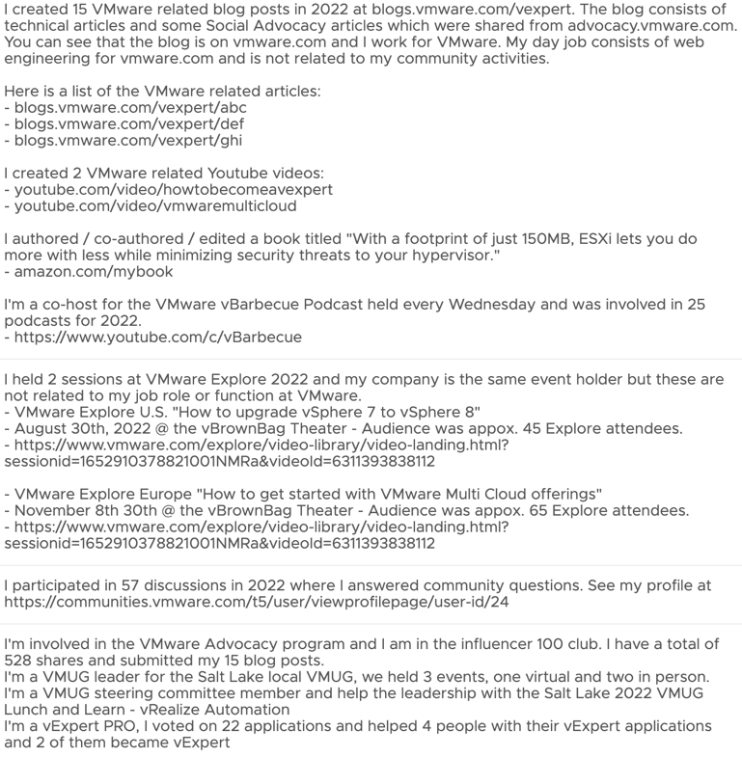
vExpert - Guidelines for Application:
What to Include (key terms underlined)
Tips for Submitting a Winning Application
Sample Application Data (This level of work is not required)
Edit your application regularly, as it remains open year-round except during voting periods. Treat it as a diary to record all community activities throughout the year.
If the contributions are related to your employer (VMware employee driving a session at Explore), explain how those contributions differ from your day job function.
Assume we have no prior knowledge about you, your role or contributions to the community when providing details.
Include details for sessions or public speaking engagements, provide date, location, subject, audience size, and a URL (if available).
Be sure the dates and authorship information are listed on your blog articles or physical publications related to VMware technical subject matter.
Give examples of both activities related to your job function and community activities.
For VMTN or other technical forums, include a profile link and links to topics where you answered questions during the previous year.
Include detailed activities for advisory boards, reference programs, customer councils and the VMware Partner Network so we can better understand what your involvement was / is.

Slide 6
vExpert - Guidelines for Application:
What to Leave Out (key terms underlined)
Examples of What Not to Include
Application Examples That We Often See
Job Function Activities (what you’re paid to do).
Older content (blogs, GitHub commits, videos, etc.) from years not relevant to the award year you are applying for. Example: The 2024 award is for work done in 2023.
Event, session, webinar. VMUG attendance.
Social Media Advocacy activities are commendable. Please note that credit for these activities is not provided within the vExpert program, we are looking for original content.
Part of other programs that are not related to giving back via sharing of information from your own experiences in your own words, voice.
Copies or paraphrased copies of VMware Docs, this is not considered content creation, it’s coping content.
Avoid submitting content that isn’t yours, that has been copied and or authored by someone else. By doing this, you will receive an automatic decline for that year and the program moving forward.
I presented to customers how to deploy VMware SDDC on AWS. (Appears to be work related, lacks details)
I created 2 blog posts in 2020 (Example: Applying for the 2024 Award) The award is for activities done in 2023. (This content falls outside of the year in review)
I spoke at a lunch I had with my internal team and talked about using VMC on AWS. (appears to be work / job function related, lacks details)
I attended the Silicon Valley VMUG (Attending isn’t considered giving back, but hosting a session would be)
I asked 7 questions in 2022 on VMTN. See my profile at… (We are looking for answered questions)
I'm in the VMware Rewards Program (A great program, being in the program wouldn’t be considered giving back to the community)
I run a large home lab running vSphere 8 and have 80 VM's running. (Building the home lab isn’t giving back but sharing the lessons you learned is).

Slide 7
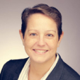
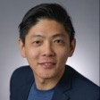
vExpert - The Application Review Process
Understanding the vExpert Selection Criteria and Voting Process
Content Criteria: We’re seeking content related to VMware that's technical in nature and provides value to our community. During our review process, we place a strong emphasis on the originality of your work, the depth of your insights, and the frequency of your engagement with the community. If you're an evangelist applying with a blog, it's crucial to remember that we assess both the frequency of your posts and the depth of your articles.
Award Criteria: Our awards are designed to honor the community contributions made during the previous year. For the 2024 award, we consider content / activities done in 2023. Your contributions should be VMware related and be distinct from your regular job responsibilities.
Application Details: We highly value applications that are in-depth and filled with relevant details. For instance, if you have speaking engagements like at VMware Explore, provide us with as many details as possible - this includes the subject matter of your talk, its location, the size of the audience, and their demographic makeup. When evaluating content such as podcasts, videos, and blog articles, we meticulously examine the material for originality, technical depth, and length. We apply this method of evaluation consistently across all types of content submitted.
Original Work & Plagiarism: We are looking for work that you have created for the benefit of the community. Sharing others work is great but it's not considered a community contribution. With plagiarism, It's important to note that we actively look for this. If you choose to use someone else's work, make sure to give them proper credit for it. Submitting someone's work as your own will cause you to forfeit the award for this year and in the future.
Meet some of the vExpert PROs who dedicate personal time to the vote on applications. The 136 people from 37 countries have asked to be part of this subprogram and take the voting responsibility seriously.
I want to personally thank each of you for your contributions and going above and beyond and asking for other ways to give back.

Slide 8
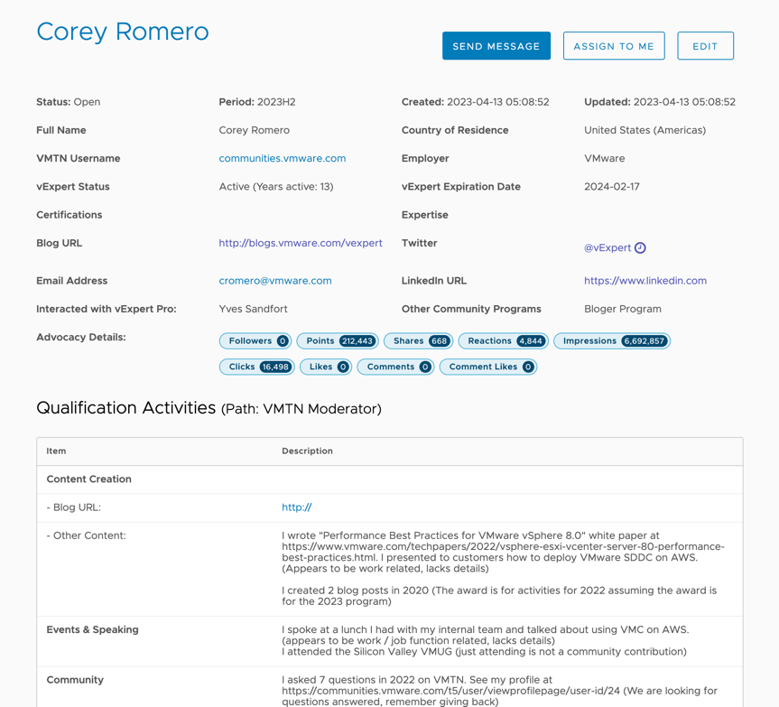
vExpert - The Voting Process Outlined
Community Apps Voted by The Community
vExpert PROs assess applications according to their country or by direct applicant request for assistance.
Applications in non-English languages are redirected to a PRO fluent in that language to prevent translation errors.
Applications from colleagues or friends are reassigned to ensure an impartial review.
If queries arise, we'll contact you via the vExpert site and email. No response before the announcement date the pending app will change to 'Not Ready' with an option to appeal.
For applications that don’t meet the minimum requirements, we will change to ”Not Ready”. Not Ready indicates we have not awarded you vExpert and a detailed reason will go out in the email sent to the applicant. We encourage everyone to Appeal if you feel the decision, was a mistake.
When we “Approve”, we also assign badges for the contributions that apply.

Slide 9
vExpert - Application Appeal Process
Guide to Successful 'Not Ready' Application Appeals: What to Include and Exclude
A ”Not Ready” app isn’t final, this is why we have appeals. During the appeal process you can submit additional community contributions that were missed or make corrections that may have been overlooked on our part.
All appeals must be done via the process, email Q&A is fine but not for appeals. If your application marked Not ready, the reason will be in the email, and this provide the basis for your appeal.
It’s also possible that the vExpert PRO misinterpreted or overlook details, and this is our mistake. If this is the case, we will find this during the appeal and make corrections.
The vExpert Appeal Process
“Not Ready” Applicants have 7 days post announcement to submit appeals. The appeals process is outlined in the email sent out on the day awards are announced. We respond to every appeal, please be patient, we will get back to you.
What to Include in Your Appeal:
Stay on point and be detailed on anything new. If you have a new session to add, include date, subject, location, audience size and URL if available.
Include additional data on what was missed by us or you.
Only include Community Contribution related information.
Links are always helpful and required for some cases. Since answering questions counts towards the vExpert award, always include profile URLs.
Example: Declined applications for public speaking often lack detail.
Be sure to include session specifics like location, date, audience size, topics,
and relevant URLs.
What to Exclude in Your Appeal:
Details that are already in your application, please don’t duplicate data.
Certifications (unless VCDX) and work details (how many VM’s, etc.)
Exclude future work. (Example: I’m writing a 4-post series on NSX next month)
How many years you have been using VMware products.
Anything day job related, not tied to “Community”
Exclude content submission that is not part of the year we are awarding.
.

Slide 10
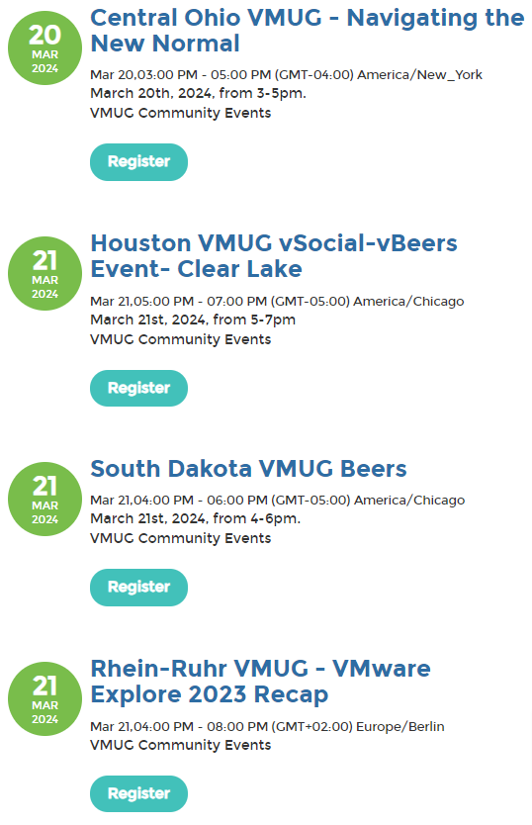
vExpert - VMUG Community Contributions
Local VMUGs Offers Opportunities to Give Back to the Community
VMUG Leadership*: VMUG leaders are vital, organizing local activities and UserCons, fostering community engagement, knowledge sharing, and collaboration with VMware to support and connect members. See VMUG Leadership details: vmug.com/get-involved/become-a-leader
Session Speaker*: VMUG members are invited to present at local events, utilizing provided resources and support. Join the VMUG 2024 Call for Content to become a speaker: vmug.com/get-involved/call-for-content-2024/
Steering Committee*: Steering Committee members support their local VMUG Leadership helping to organize meetings and events. If you are interested in joining the Steering Committee, reach out to your local VMUG leader.
Get Involved in Your Local VMUG
The General Membership gives you access to: UserCons, Virtual Events, Local Meetings, Online Communities, Live & On-Demand Webcasts.
The Advantage Membership offers the General benefits plus 20-30% discounts on VMware training, 1 Year Eval licenses, Explore Discount, and a TestDrive Account. Learn more: vmug.com/membership/vmug-advantage-membership. Tip: Build a home lab using the 365-day eval licenses, create & share content from your experience and apply for the vExpert award.
Find a Local VMUG UserCon

Slide 11
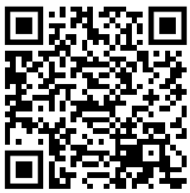
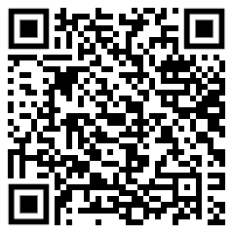
vExpert - Use the Follow Me Thread
Leverage these QR Codes to Join in on the Follow Me Thread on Twitter and LinkedIn

Slide 12
vExpert Best Practice Guide: Thank You
Questions?
For questions regarding the vExpert program, applications, appeals or any other topics please reach out to via the resources below.
Resources:
vExpert PROs can be found and contacted through the vExpert Directory at vexpert.vmware.com/directory/pro
Program Manager: Corey Romero corey.romero@broadcom.com.
Apply for the vExpert Program: vexpert.vmware.com/apply.

